Slide 1
Strictly Manual Production
Transformable Production
Future
Flexibility, Production Variety
Fully Automated Production
Today
Volume, Degree of Automation

Slide 2
ROS Master
Registration Information
Registration Information
Node A
Message Topic
Node A
Publisher
Subscriber
Server
Client
Request
Service Topic
Reply

Slide 3
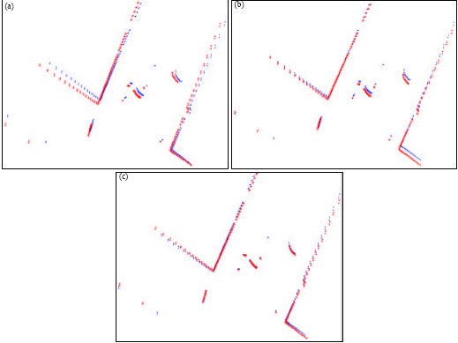
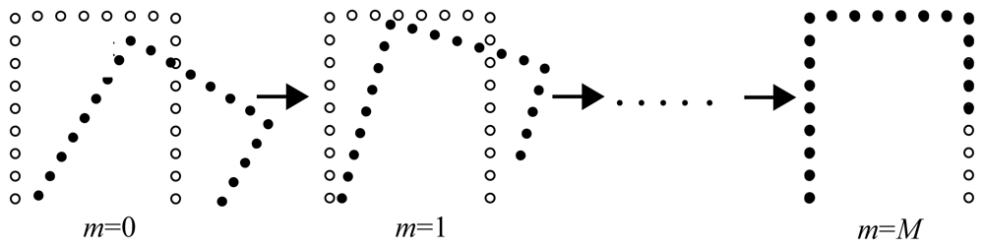

Slide 4
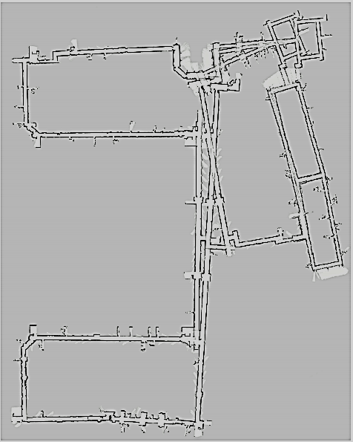
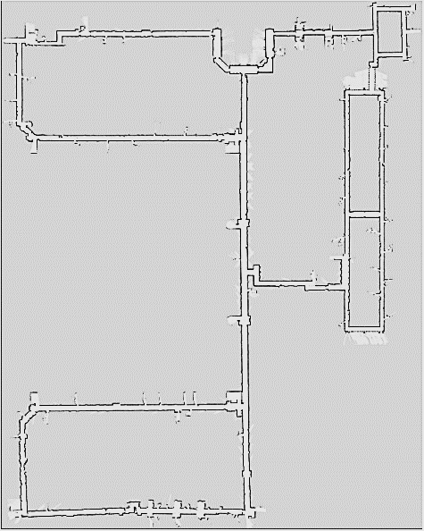
Optimized State
Front-End
Back-End
Sensor Messages
Optimized Map
Estimation Parameters
Feature Extraction
Map Generation
State Variables
Odometry
Scan Matching
Map Optimization

Slide 5
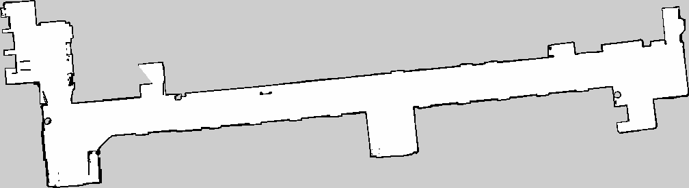

Slide 6
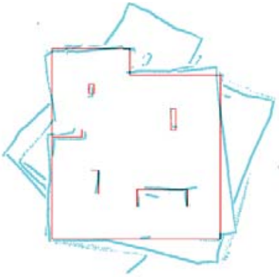
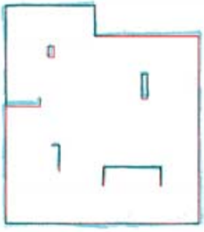
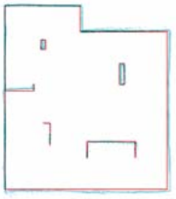
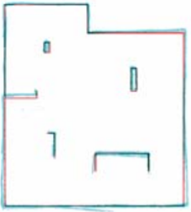
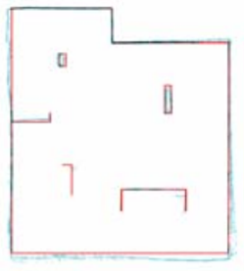
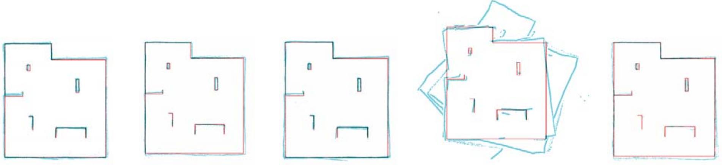
HectorSLAM
GMapping
KartoSLAM
CoreSLAM
LagoSLAM
(a) HectorSLAM
(b) GMapping
(c) KartoSLAM
(d) CoreSLAM
(e) LagoSLAM

Slide 7
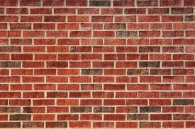
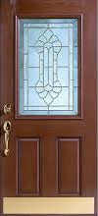
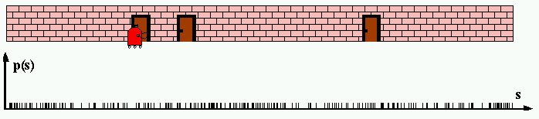
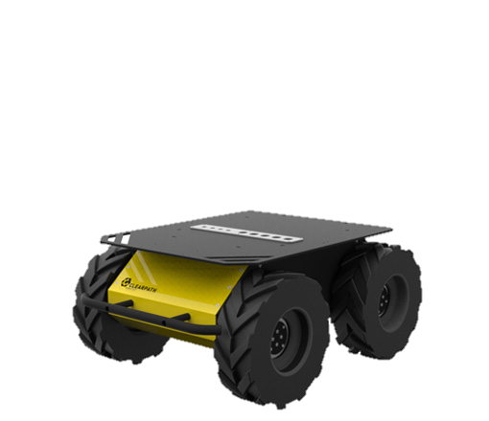
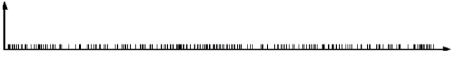
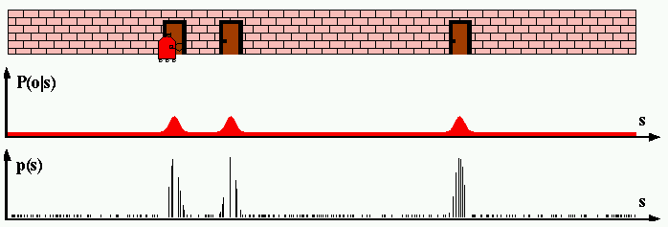
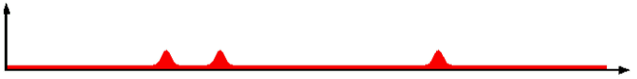
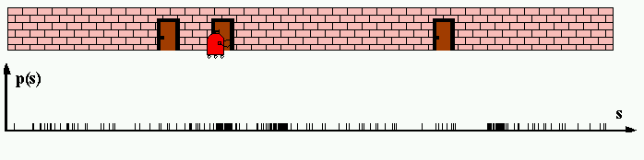
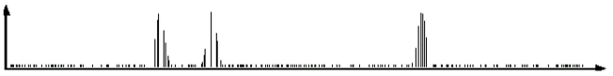
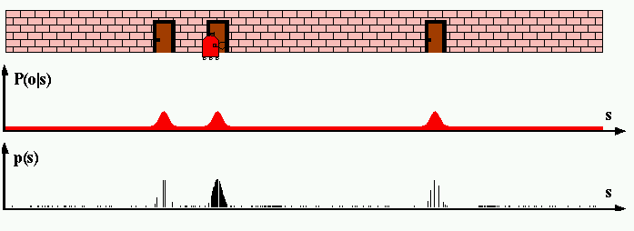
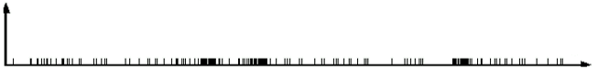
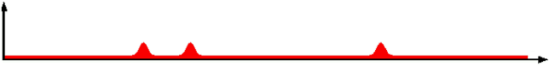
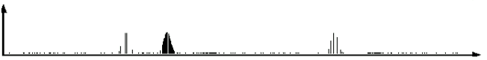
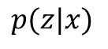
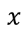
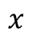
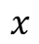
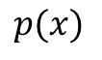
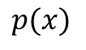
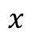
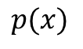
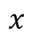
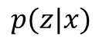
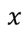
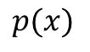
At time t = 1
Robot
Door
$$p(x)$$
Belief State
$$x$$
$$p(z|x)$$
Measurement Model
$$x$$
$$p(x)$$
Belief State
At time t = 2, robot moves forward some distance
$$x$$
$$p(x)$$
d
Motion Model Update
$$x$$
$$p(z|x)$$
Measurement Model
$$x$$
$$p(x)$$
Belief State
$$x$$

Slide 8
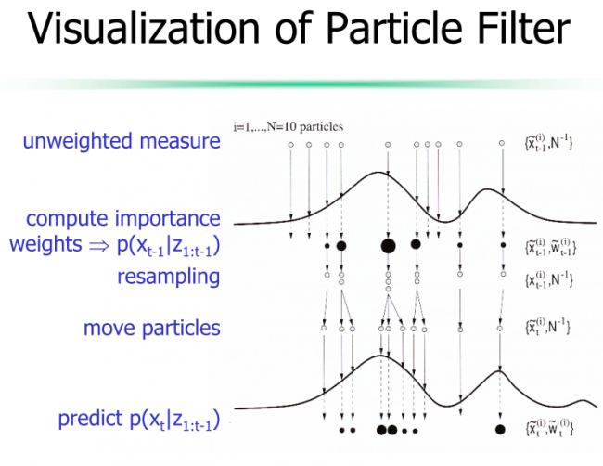
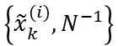
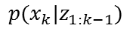
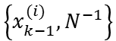
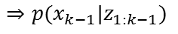
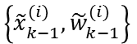
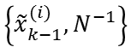
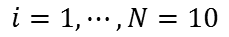
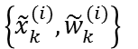
$$i=1, ⋯, N=10$$
particles
Unweighted Measure
$$\left\{{\tilde{x}}_{k−1}^{(i)},N^{−1}\right\}$$
Compute Importance
$$\left\{{\tilde{x}}_{k−1}^{(i)},{\tilde{w}}_{k−1}^{(i)}\right\}$$
Weights
$$⇒p(x_{k−1}|z_{1:k−1})$$
Resampling
$$\left\{x_{k−1}^{(i)},N^{−1}\right\}$$
Distribute Particles
$$\left\{{\tilde{x}}_{k}^{(i)},N^{−1}\right\}$$
Predict
$$p(x_{k}|z_{1:k−1})$$
$$\left\{{\tilde{x}}_{k}^{(i)},{\tilde{w}}_{k}^{(i)}\right\}$$

Slide 9
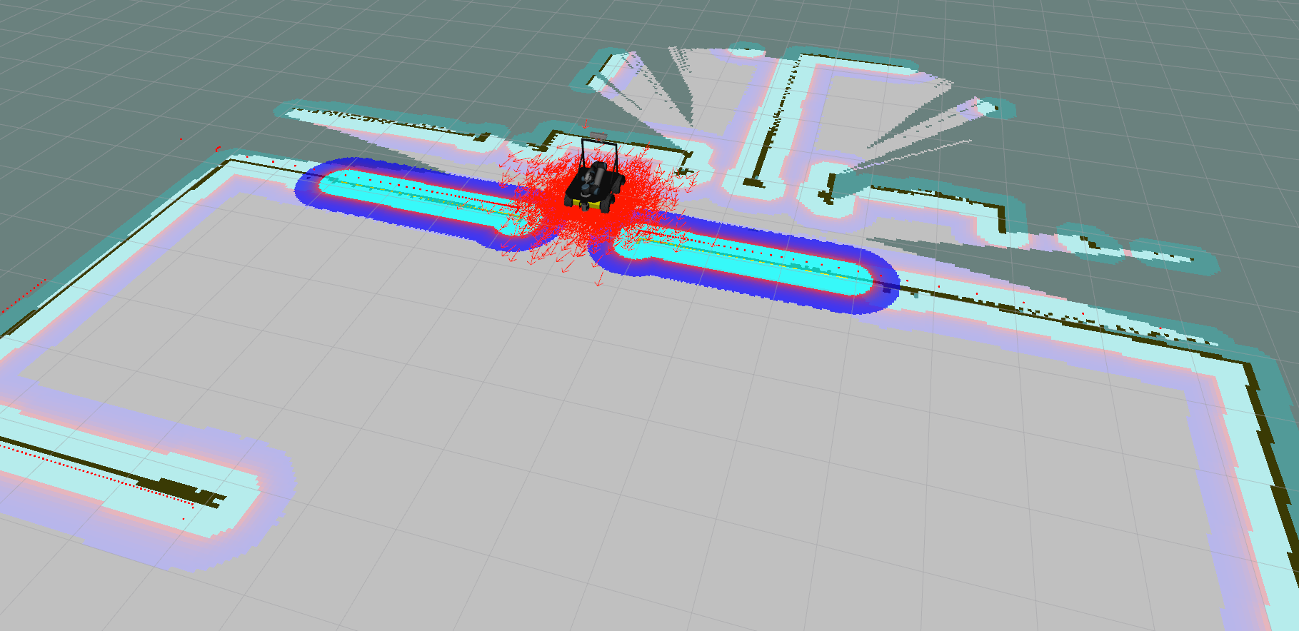
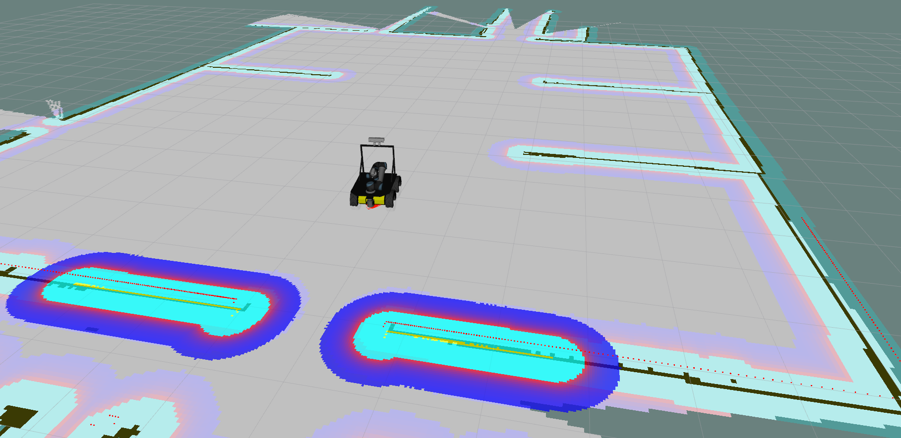
Initial Particle Cloud for Robot
Refined Particle Cloud

Slide 10
Initial Particle Cloud for Robot
Refined Particle Cloud

Slide 11
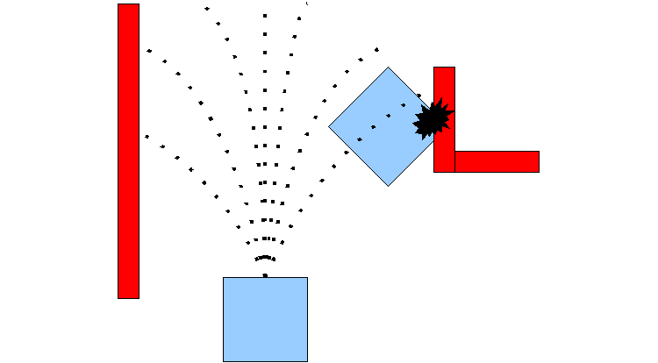

Slide 12
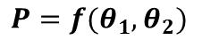
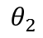






P
P
P
P
$$θ_{1}$$
$$θ_{1}$$
$$θ_{1}$$
$$θ_{1}$$
$$θ_{2}$$
$$θ_{2}$$
$$θ_{2}$$
$$θ_{2}$$
Forward Kinematics
Inverse Kinematics
Forward Kinematics
Inverse Kinematics
$$P=f(θ_{1},θ_{2})$$
$$θ_{1},θ_{2}=f^{−1}(P)$$
$$P=f(θ_{1},θ_{2})$$
$$θ_{1},θ_{2}=f^{−1}(P)$$

Slide 13


Slide 14
Yellow
White
255, 255, 0
255, 255, 255
Green
Cyan
0, 255, 0
0, 255, 255
Red
Magenta
255, 0, 0
255, 0, 255
Black
Blue
RGB Color Space
HSV Color Space
0, 0, 0
0, 0, 255
Value
Yellow
White
Green
Yellow
255, 255, 0
255, 255, 255
120°
White
60°
Green
Cyan
Cyan
1.0
Red
0, 255, 0
0, 255, 255
180°
Blue
Magenta
0°
240°
300°
255, 0, 0
Red
255, 0, 255
Magenta
0, 0, 0
0, 0, 255
Black
Hue
Saturation
Black
Blue
0.0
1.0

Slide 15







Gaussian Noise
Gaussian Filtered Image
Original Image
Salt and Pepper Noise
Median Filtered Image
Blurred Image
Sharpened Image

Slide 16


Unequalized Histogram
Equalized Histogram

Slide 17


Unequalized Image
Equalized Image

Slide 18





Original
Erosion
Dilation
Closing (Dilation/Erosion)
Opening (Erosion/Dilation)

Slide 19


Original Image
Edges

Slide 20

Intersection: most votes for center occur here.
y
b
0
x
0
Image space
Hough space
Image Space
a
Hough Space

Slide 21

r
b
a

Slide 22

“Flat” Region:
No Change In All Directions
“Edge”:
No Change Along Edge Direction
“Corner”:
Significant Change in All Directions

Slide 23
“Flat” Region:
No Change In All Directions
“Edge”:
No Change Along Edge Direction
“Corner”:
Significant Change in All Directions

Slide 24


Flat
Edge
Corner
Input Image Patch
X Derivative
Y Derivative

Slide 25









Flat
Edge
Corner
Input Image Patch
X Derivative
Y Derivative

Slide 26



















$${λ }_{2}$$
“Edge”
$$R<0$$
Good Feature
Harris Corner
“Edge”
$${λ }_{2}$$
“Corner”
$$R<0$$
$$R>0$$
“Corner”
$$R>0$$
“Flat”
“Edge”
$\left|R\right|$ small
$$R<0$$
$${λ }_{min}$$
$${λ }_{1}$$
“Flat”
“Edge”
$\left|R\right|$ small
$$R<0$$
$${λ }_{min}$$
$${λ }_{1}$$

Slide 27










“Edge”
$${λ }_{2}$$
$${λ }_{2}$$
“Edge”
$$R<0$$
$$R<0$$
“Corner”
“Corner”
$$R>0$$
$$R>0$$
$${λ }_{min}$$
“Flat”
“Edge”
“Flat”
“Edge”
$\left|R\right|$ small
$$R<0$$
$\left|R\right|$ small
$$R<0$$
$${λ }_{min}$$
$${λ }_{1}$$
$${λ }_{1}$$
(a)
(b)

Slide 28







Original Image
Convert to Grayscale Image
Adaptive Thresholding
Detect Contours
Run Acceptance/Rejection Tests
Identify Marker
0
Optimize Corner Locations
Calculate Marker Pose

Slide 29





Slide 30


Slide 31







$$\sum_{x}{{\left[T\left(W\left(x;∆p\right)\right)−I\left(W\left(x;p\right)\right)\right]}^{2}}$$
$$T_{x}$$
$$T_{y}$$
Initial Condition
Global Minimum

Slide 32


Viewfinder
Pentaprism
Aperture
Sensor
Shutter
Mirror
Lens

Slide 33



17 km spatial resolution
9 km spatial resolution
1 km spatial resolution

Slide 34


Original Image
Global Shutter
Rolling Shutter

Slide 35
Finite State Machine
Easily Expandable Framework
Robot Returns to Charging Station Between Missions if Necessary
Customer Input
Charges Between Tasks if Necessary
Easily Expandable to More Tasks

Slide 36
Drilling Station
Charging Station
Sealant Application Station

Slide 37
Drilling Station
35 m
30 m
20 m
Charging Station
Sealant Application Station

Slide 38

Drilling Station
20 m
40 m
5 m
10 m
Sealant Application Station

Slide 39

Drilling Station
5 m
10 m
20 m
40 m
Sealant Application Station

Slide 41


Slide 42

Reference
Measured Error
Controller
Joint Angles
Manipulator
Manipulator Pose
Measured Pose
Camera

Slide 43



Slide 44
Flexible Framework
Robust Feature Detection
Reports Errors or Non-Reachable Holes to Customer
Notifies Customer of Problems
To Specified Depth and at Specified Feed Rate
Using Canny Edge Detection, Hough Transform, and KLT Tracker

Slide 45
Flexible Framework
Robust Feature Detection
Reports Errors or Non-Reachable Holes to Customer
Notifies Customer of Problems
To Specified Depth and at Specified Feed Rate
Using Canny Edge Detection, Hough Transform, and KLT Tracker

Slide 46
Flexible Framework
Robust Feature Detection
Reports Errors or Non-Reachable Corners to Customer
Notifies Customer of Problems
Using Good Feature Detection and KLT Tracker

Slide 47
Flexible Framework
Robust Feature Detection
Reports Errors or Non-Reachable Corners to Customer
Notifies Customer of Problems
Using Good Feature Detection and KLT Tracker

Slide 48
Flexible Framework
Robust Feature Detection
Reports Errors or Non-Reachable Corners to Customer
Notifies Customer of Problems
Using Good Feature Detection and KLT Tracker

Slide 49


RGB-D Camera
RGB Camera
Laser Pointer
Manipulator
Lidar

Slide 50

Camera
Calibration Pattern

Slide 51



Slide 52




Slide 53
Extracted Corners
Extracted Laser Center

